Slide 1
UI Overview

Slide 2
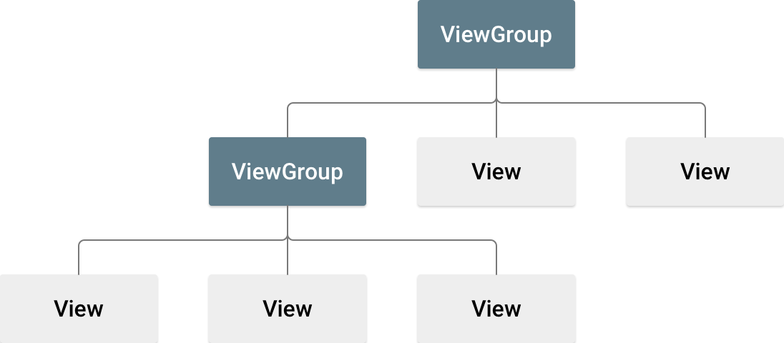

Slide 3
All user interface elements in an Android app are built using View and ViewGroup objects.
A View is an object that draws something on the screen that the user can interact with.
A ViewGroup is an object that holds other View (and ViewGroup) objects in order to define the layout of the interface.
The name of an XML element for a view is respective to the Android class it represents.
So a <TextView> element creates a TextView widget in your UI, and a <LinearLayout> element creates a LinearLayout view group.

Slide 4
Layouts

Slide 5
A layout defines the visual structure for a user interface,

Slide 6
<?xml version="1.0" encoding="utf-8"?> <LinearLayout xmlns:android="http://schemas.android.com/apk/res/android" android:layout_width="fill_parent" android:layout_height="fill_parent" android:orientation="vertical" > <TextView android:id="@+id/text" android:layout_width="wrap_content" android:layout_height="wrap_content" android:text="I am a TextView" /> <Button android:id="@+id/button" android:layout_width="wrap_content" android:layout_height="wrap_content" android:text="I am a Button" /> </LinearLayout>

Slide 7
Load the XML Resource
When you compile your application, each XML layout file is compiled into a View resource.
You should load the layout resource from your application code, in your Activity.onCreate() callback implementation.
Do so by calling setContentView(), passing it the reference to your layout resource in the form of: R.layout.layout_file_name.
For example, if your XML layout is saved as main_layout.xml, you would load it for your Activity like so:
public void onCreate(Bundle savedInstanceState) { super.onCreate(savedInstanceState); setContentView(R.layout.main_layout); }
The onCreate() callback method in your Activity is called by the Android framework when your Activity is launched

Slide 8
Layout Attributes
Each layout has a set of attributes which define the visual properties of that layout. There are few common attributes among all the layouts and their are other attributes which are specific to that layout. Following are common attributes and will be applied to all the layouts:
android:id
This is the ID which uniquely identifies the view.
android:layout_width
This is the width of the layout.
android:layout_height
This is the height of the layout
android:layout_marginTop
This is the extra space on the top side of the layout.
android:layout_marginBottom
This is the extra space on the bottom side of the layout.

Slide 9
android:layout_marginLeft
This is the extra space on the left side of the layout.
android:layout_marginRight
This is the extra space on the right side of the layout.
android:layout_gravity
This specifies how child Views are positioned.
android:layout_weight
This specifies how much of the extra space in the layout should be allocated to the View.

Slide 10
android:layout_x
This specifies the x-coordinate of the layout.
android:layout_y
This specifies the y-coordinate of the layout.
android:layout_width
This is the width of the layout.
android:layout_width
This is the width of the layout.
android:paddingLeft
This is the left padding filled for the layout.
android:paddingRight
This is the right padding filled for the layout.
android:paddingTop
This is the top padding filled for the layout.
android:paddingBottom
This is the bottom padding filled for the layout.

Slide 11
View Identification
A view object may have a unique ID assigned to it which will identify the View uniquely within the tree. The syntax for an ID, inside an XML tag is −
Following is a brief description of @ and + signs −
android:id="@+id/my_button"
The at-symbol (@) at the beginning of the string indicates that the XML parser should parse and expand the rest of the ID string and identify it as an ID resource.
The plus-symbol (+) means that this is a new resource name that must be created and added to our resources. To create an instance of the view object and capture it from the layout, use the following −
Then create an instance of the view object and capture it from the layout (typically in the onCreate() method):
Button myButton = (Button) findViewById(R.id.my_button);

Slide 12
You can specify width and height with exact measurements, though you probably won't want to do this often. More often, you will use one of these constants to set the width or height:
wrap_content tells your view to size itself to the dimensions required by its content.
match_parent tells your view to become as big as its parent view group will allow.
In general, specifying a layout width and height using absolute units such as pixels is not recommended. Instead, using relative measurements such as density-independent pixel units (dp), wrap_content, or match_parent, is a better approach, because it helps ensure that your application will display properly across a variety of device screen sizes.

Slide 13

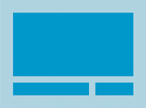
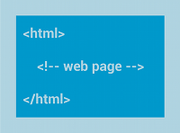
Common Layouts
Each subclass of the ViewGroup class provides a unique way to display the views you nest within it. Below are some of the more common layout types that are built into the Android platform.
Linear Layout
Relative Layout
Web View
Linear Layout
A layout that organizes its children into a single horizontal or vertical row. It creates a scrollbar if the length of the window exceeds the length of the screen.
Relative Layout
Enables you to specify the location of child objects relative to each other (child A to the left of child B) or to the parent (aligned to the top of the parent).
Web View
Displays web pages.

